Slide 1



Quality of Care for Chronic Disease Management
Vaibhav Gaikwad // 2018HT12597
BIRLA INSTITUTE OF TECHNOLOGY & SCIENCE
PILANI (RAJASTHAN)
April 2020

Slide 2
Nobody ever figures out what life is all about, and it doesn't matter. Explore the world. Nearly everything is really interesting if you go into it deeply enough.
- Richard P. Feynman

Slide 3
Introduction
In the healthcare domain, the applications are built around the idea of providing care.
Philips VitalHealth has various chronic disease management solutions build for diseases (e.g. Diabetes, COPD, Asthma, etc.).
Philips culture supports innovation to add more value to the products for staying ahead of the competition.
One of the widely talked Unique Selling Point (USP) is about Quality of Care (QoC) in the solutions.
The dissertation work focuses on the research of building a model for the assessment of QoC.

Slide 4
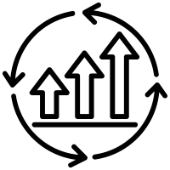
Motivations
Analysis of Quality of Care (QoC) is about gaining information about the effectiveness of care management for the patients.
QoC is stated good when the health of the population is stable or improving.
QoC is also a measure of the effectiveness of a treatment protocol.
QoC in a business case means proving the ROI (return on investments) to customers.
QoC measurement is a must for accountable care as per CDC’s Meaningful Use policy.

Slide 5
Observations & Objectives
Observations
Current solutions have little or no way to assess the QoC.
Knowledge related to QoC is observed in the people but is not yet implemented.
Ad-hoc methods are adopted for QoC report generation on a need basis.
Data needed for assessing QoC is present in the existing system.
Objectives
Define a way to find QoC attributes for an application
Propose a model to assess the QoC using those attributes

Slide 6




Work Summary
Division of work
Ideation and design
Data collection and analysis
Searching for risk groups
Design for Quality of Care

Slide 7
Ideation
Brainstorming sessions helped to understand the ways to find QoC.
Summarizing the patient feedback at the overall level gives information about the quality of care.
The adoption of such a method does not seem very accurate and feedback is always optional.
Trend analysis of each patient’s health can also provide details on the Quality of Care.
This method is time-consuming and does not generate insights on the population level.
Compare data from previously used applications which have proved better Quality of Care.
It is difficult to achieve due to the dependency on finding a trustable system.
Research requirement was gathered, and a proposal was made with the objectives.
Research a way to find QoC attributes for an application.
Propose a model to assess the QoC using those attributes.

Slide 8
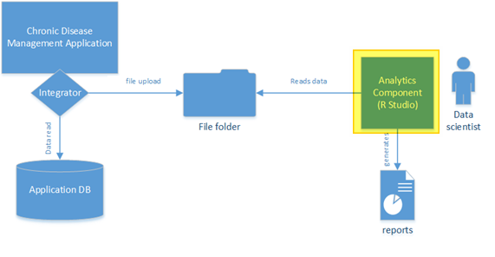
Ideation System block diagram
The focus is on the design of the Analytics Component.
Rest of the integrations will be considered during the actual implementation.

Slide 9
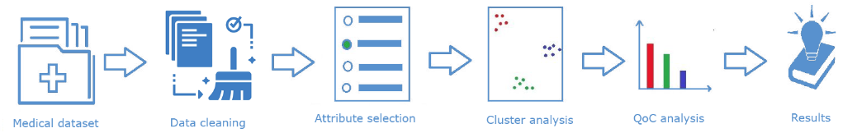
Ideation Analytics Component
Chronic Disease Management (CDM) application holds the medical data, and can be exported.
Data cleaning removes insignificant data from the exported dataset.
Attribute selection helps to find the valuable data attributes helpful for clustering.
Cluster analysis helps to understand the risk-based group formations.
QoC analysis will help in understanding if the care management is effective or not.
Results will be the reports that are generated for the care organisation.

Slide 10
Data Analysis Collection
Privacy contracts made it difficult to use applications with live data.
Dataset from Kaggle.com was used referred to as PIMA dataset, which had 786 records for diabetic and non-diabetic female patients.
Following eight data attributes were present as listed in the table.
Data attribute | Description
Pregnancies | Number of times pregnant
Glucose | Plasma glucose concentration (2 hours) oral glucose tolerance
BloodPressure | Diastolic blood pressure (mm Hg)
SkinThickness | Triceps skinfold thickness (mm)
Insulin | 2-hour serum insulin (mu U/ml)
DiabetesPedigreeFunction | Score for likelihood of Diabetes based on family history
BMI | Body mass index (weight in kg / (height in m) ^2)
Age | Age for a person in years
Outcome | Class variable (0 or 1) whether or not a patient has Diabetes

Slide 11
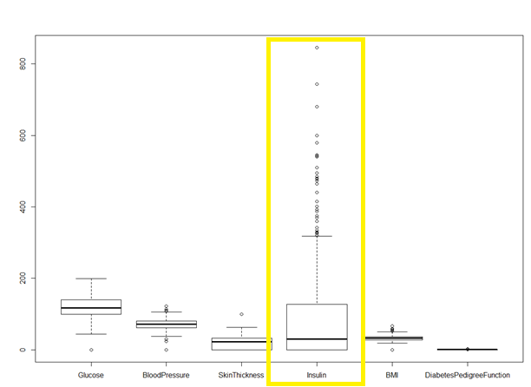
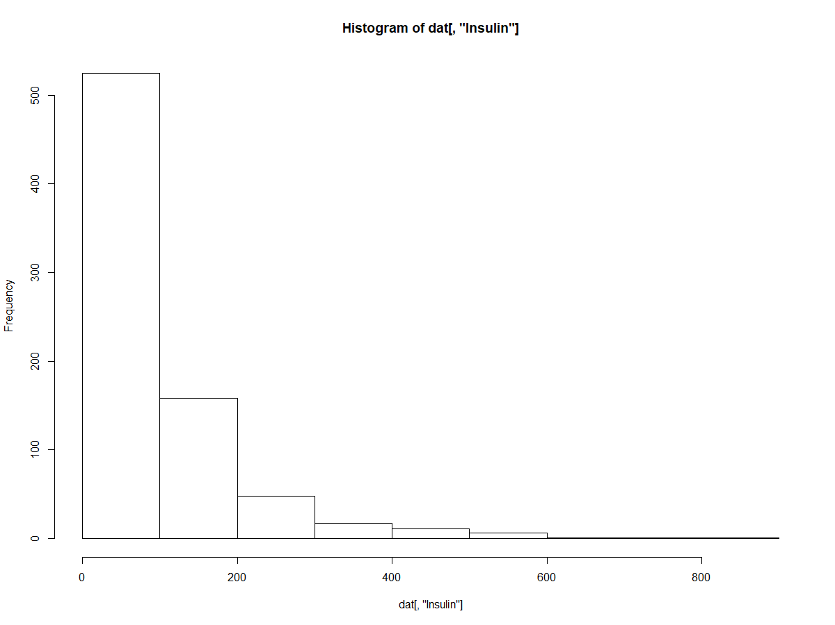
Data Analysis Cleaning
As study was not gender specific “Pregnancies” data was neglected.
Removal of records with 0 value for Glucose, Blood Sugar, BMI.
Number of were reduced to 249 after the data cleaning process.

Slide 12
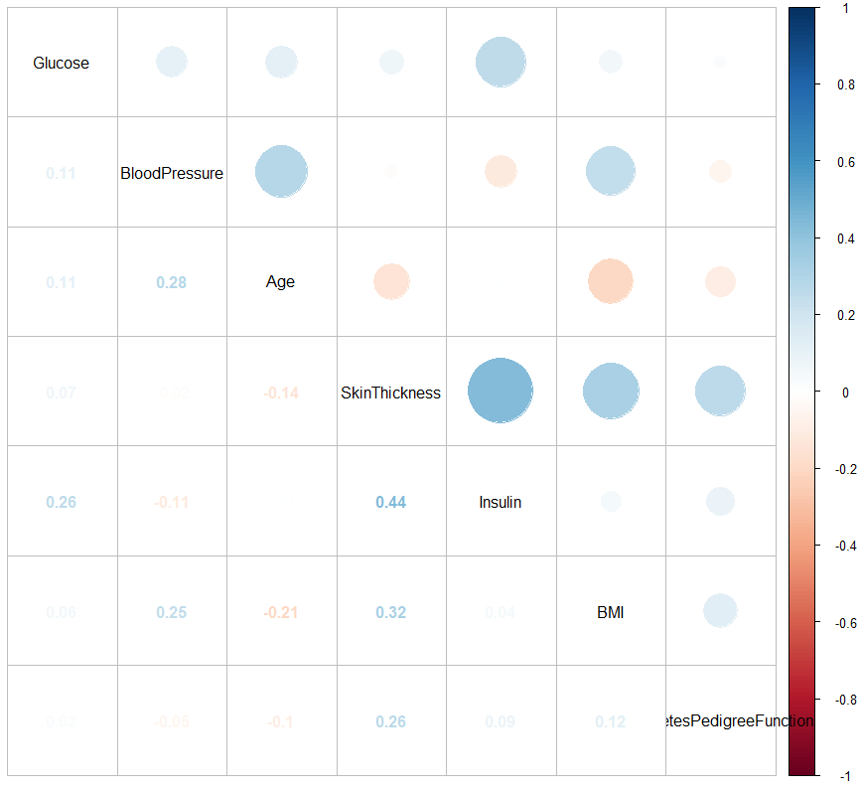
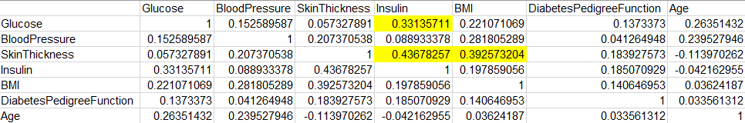
Data Analysis Correlations among attributes
Correlations in filtered data with strong correlations are listed below
Glucose and Insulin (obvious)
SkinThickness and Insulin
SkinThickness and BMI

Slide 13
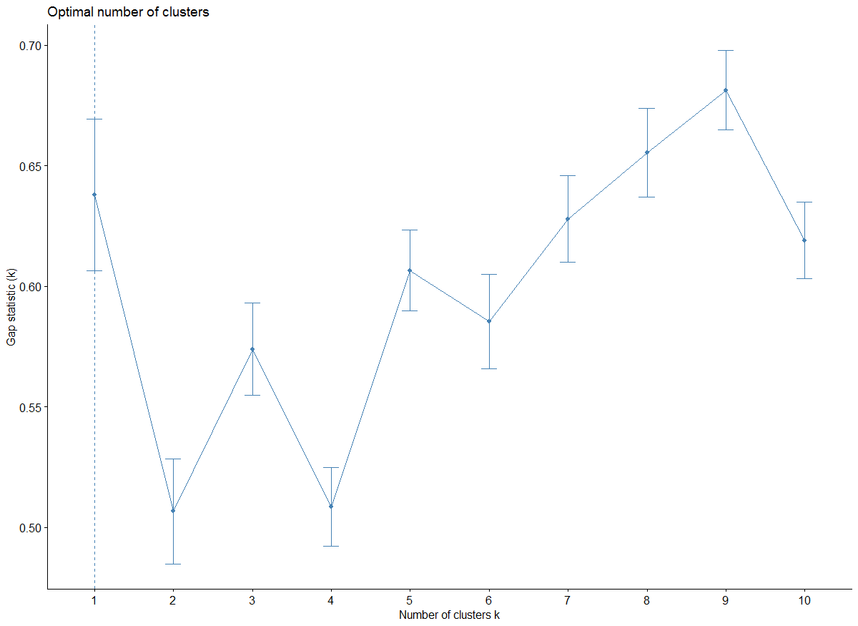
Search Risk Groups Standard K-means (gap-stat)
K-means execute with gap-stat indicated the data is not separable, as optimal K value was 1.
K-means with all eight data attributes for K = 3 was not useful.
Conclusion: Data was not easily separable into groups based on risk using default K-means.

Slide 14
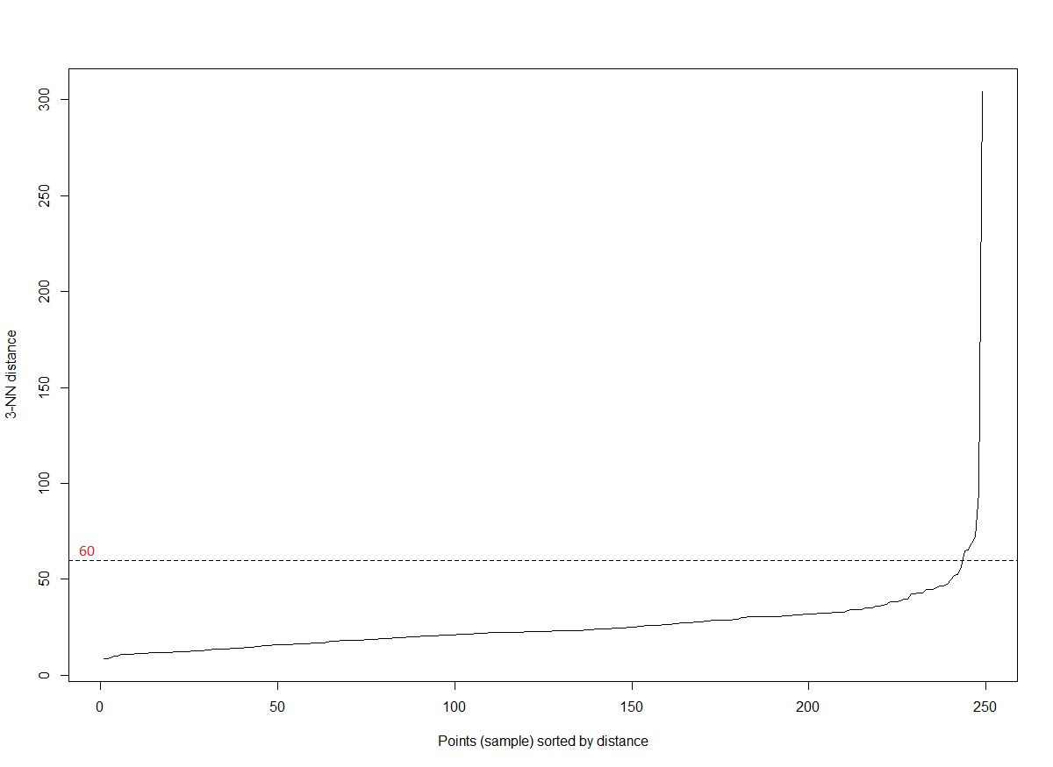
Search Risk Groups Standard DBSCAN (kNN)
DBSCAN was tested with kNN for K = 3 and min eps distance was observed to be between 60 to 80
DBSCAN with eps = 60 and MinPts = 5, generated 2 clusters but did not generate any useful results in regards to the risk groups.
Conclusion: DBSCAN is not a correct choice to proceed, as data is not easily separable.

Slide 15
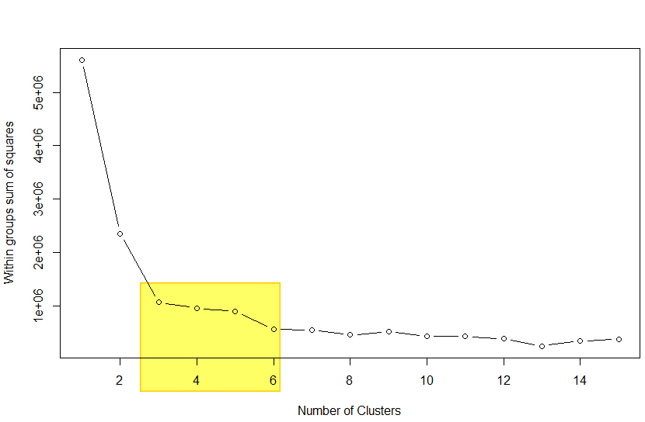
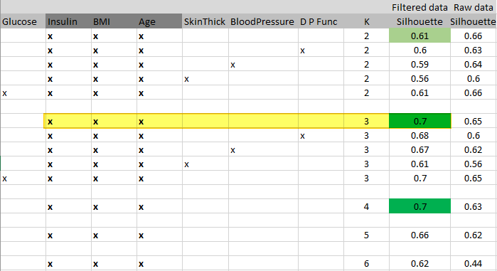
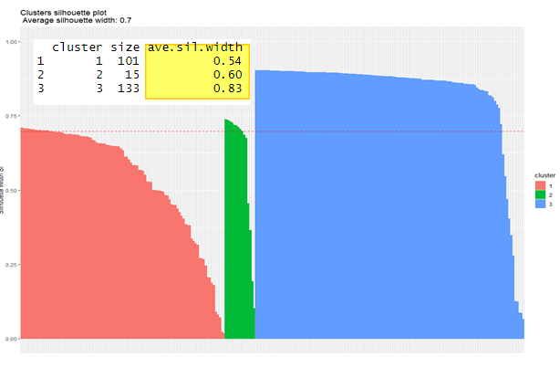
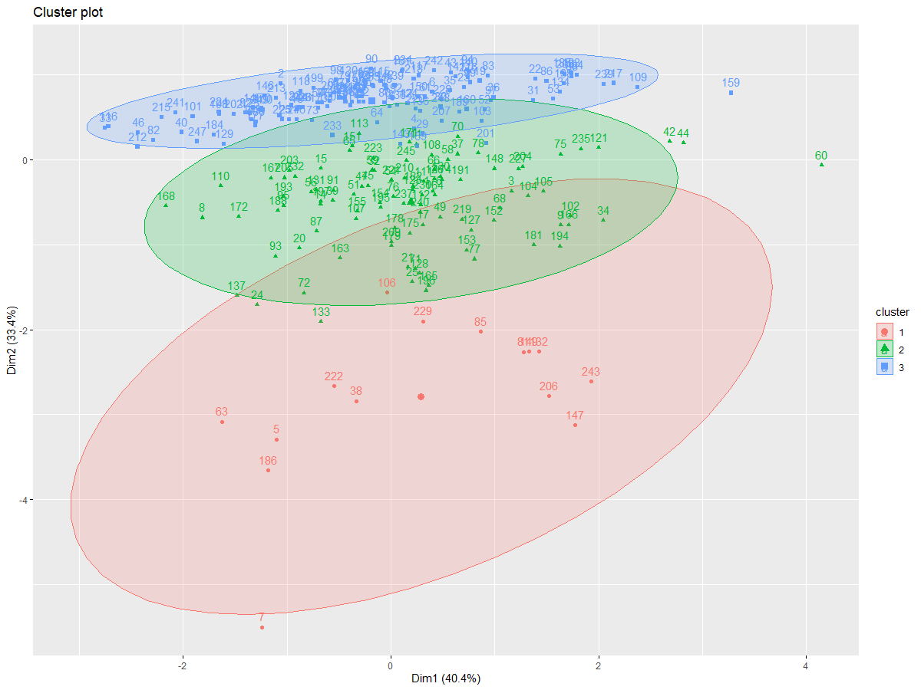
Search Risk Groups K-means clustering & Silhouette analysis
Elbow analysis confirmed K = 3 lies in optimal section.
Silhouette analysis iterations were carried for K [2-6] to find the attributes which resulted in good clustering in K-means.
Attributes [Insulin, BMI, Age] were found promising at value 0.7 for Average Silhouette Width (ASW).

Slide 16
Search Risk Groups Range formation
The Insulin based range formation was visible.
Cluster 3 has a low range [0-9].
Cluster 1 has the moderate range [96 - 328].
Cluster 2 has the high range [360 - 846].
The result was not promising so attribute selection with Random Forest method was performed and clustering was redone.
Cluster No. | Glucose | BloodPressure | Insulin | BMI | Age
Cluster 1 | 88 - 198 | 30 - 110 | 96 - 328 | 23.4 - 67.1 | 21 - 58
Cluster 2 | 124 - 197 | 50 - 90 | 360 - 846 | 28 - 46.2 | 21 - 60
Cluster 3 | 78 - 199 | 50 - 114 | 0 - 91 | 22.9 - 59.4 | 21 - 70

Slide 17
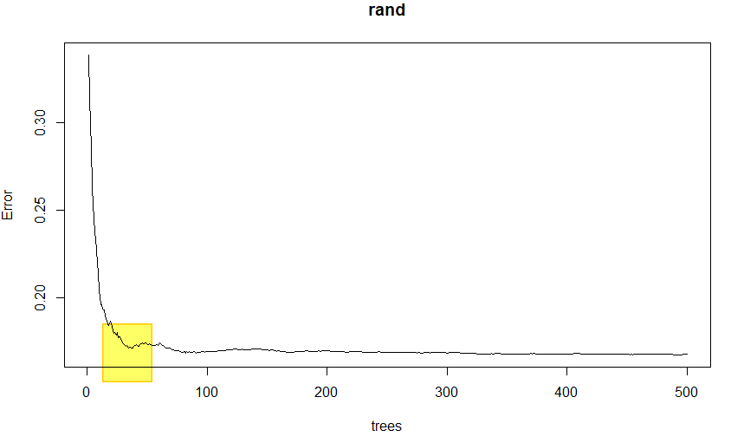
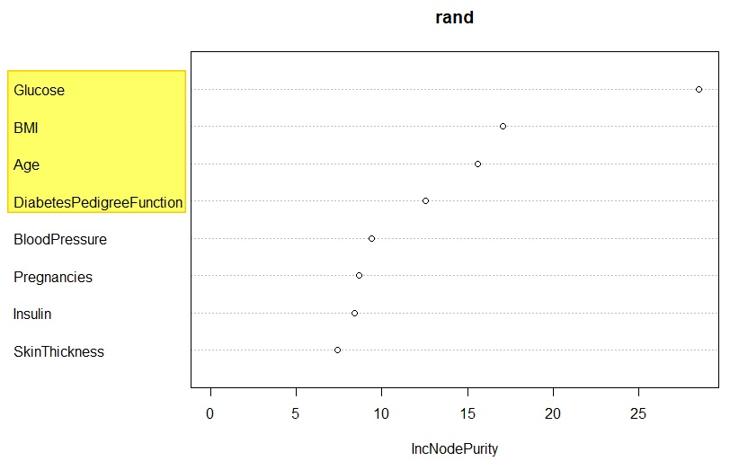
Search Risk Groups Random Forest and Attribute Selection
Random Forest indicated the optimal attribute combination was [Glucose, BMI, Age]. If range formation is not observed then DPF attribute can be added.
Positive results were seen using the [Glucose, BMI, Age] after clustering.
ASW = 0.37 was observed and was comparatively low but still in the valid range (positive).
Cluster No. | Glucose | BloodPressure | Insulin | BMI | Age
Cluster 1 | 78 - 125 | 30 - 100 | 0 - 258 | 22.9 - 55 | 21 – 62
Cluster 2 | 160 - 199 | 50 - 110 | 0 - 846 | 23.3 - 59.4 | 21 – 66
Cluster 3 | 123 - 159 | 40 - 114 | 0 - 600 | 23.8 - 67.1 | 21 - 70

Slide 18
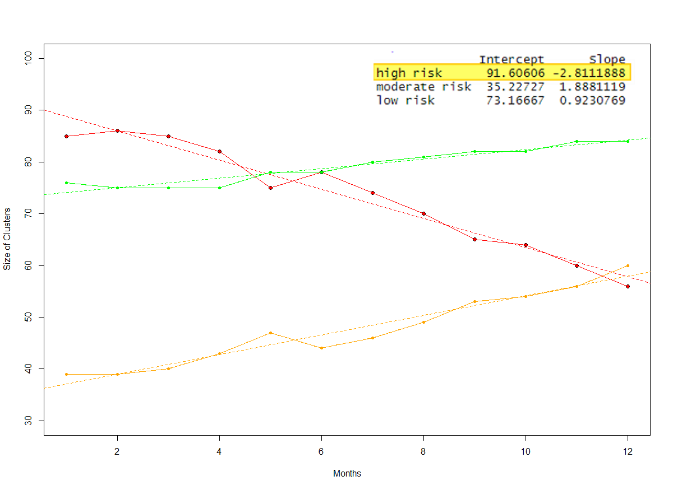
QoC design
Clustering Confidence Score (CCS) – was defined as new terms which gives the percentage of valid data points in range to the actual world. Values lies in range [0 - 10]. Score above 7 is reliable.
CCS = [[Number of correctly identified data points in all significant data attributes in the respective ranges] / [Total number of data points]] × 10
Design was based on trend analysis of cluster sizes that are generated from the previous steps.
The focus is on the high-risk cluster size, decreasing trend of high-risk cluster indicates good QoC.
Following example data is plotted (C1: high risk cluster)
Simple linear regression (colour: red) line is added + slope details
Negative slope: Good QoC (for high risk)
 | Jan | Feb | Mar | Apr | May | Jun | Jul | Aug | Sep | Oct | Nov | Dec
C1 | 85 | 86 | 85 | 82 | 75 | 78 | 74 | 70 | 65 | 64 | 60 | 56
C2 | 39 | 39 | 40 | 43 | 47 | 44 | 46 | 49 | 53 | 54 | 56 | 60
C3 | 76 | 75 | 75 | 75 | 78 | 78 | 80 | 81 | 82 | 82 | 84 | 84

Slide 19
Conclusion
Real life data on diseases like Diabetes, is not easily separable into clusters using default method of K-means or DBSCAN method. Assumption related to good separated clusters should generate risk-based groups was found to be incorrect.
Unsupervised learning (K-means clustering) helps in analysis of risk-based groups when we find the right set of data attributes.
Random Forest provides better results for attribute selection compared to Average Silhouette Width analysis.
Cluster Confidence Score plays an important role to validate the learning from the model from a medical professional.
Risk-based groups formation was observed after taking the attributes provided by Random Forest approach when prediction accuracy was acquired around 80%.
QoC for existing and new systems do have similar models based on trend of size of clusters.

Slide 20
References
M. J. Hallett, J. J. Fan, X. G. Su, R. A. Levine and M. E. Nunn, “Random forest and variable importance rankings for correlated survival data, with applications to tooth loss,” Statistical Modelling, pp. 523-547, 2014.
B. Rai, “Feature Selection and Predictive Modeling of Housing Data Using Random Forest,” International Journal of Business and Economics Engineering, vol. 11, no. 4, pp. 919-923, 2017.
C. Chapman and E. M. Feit, “R for Marketing Research and Analytics,” in R for Marketing Research and Analytics, Springer Nature, 2015, pp. 331,332,333.

Slide 21
THANKS

